Slide 1
Chapter 2
How to code, test, and validate a web page

Slide 2
Objectives
Applied
Use a text editor like VS Code to create, edit, and test HTML and CSS files.
Test an HTML document that’s stored on your computer or a local server by loading it into a browser.
Use the W3C HTML and CSS Validation Services to validate HTML and CSS files.
Knowledge
Describe the use of the head and body elements in an HTML document.
Describe these types of HTML tags: opening, closing, and empty.
Describe the use of attributes within HTML tags.
Describe the use of HTML comments and whitespace.

Slide 3
Objectives (continued)
Describe the components of a CSS style rule.
Describe the use of these types of CSS selectors: type, id, and class.
Describe two ways to run a web page and one way to retest a page after you’ve changed and saved the source code for the page.

Slide 4
The basic structure of an HTML document

Slide 5
A simple HTML document
<!DOCTYPE html>
<html lang="en">
<head>
<meta charset="utf-8">
<title>San Joaquin Valley Town Hall</title>
</head>
<body>
<h1>San Joaquin Valley Town Hall</h1>
<p>Welcome to San Joaquin Valley Town Hall</p>
<p>We have some amazing speakers in store for you
this season!</p>
<p><a href="speakers.html">Speaker
information</a></p>
</body>
</html>

Slide 6
Working with tags
Two elements with opening and closing tags
<h1>San Joaquin Valley Town Hall</h1>
<p>Here is a list of links:</p>
Two empty tags
<br>
<img src="logo.gif" alt="Murach Logo">

Slide 7
Correct and incorrect nesting of tags
Correct nesting
<p>Order your copy <i>today!</i></p>
Incorrect nesting
<p>Order your copy <i>today!</p></i>

Slide 8
How to code an opening tag with attributes
An opening tag with one attribute
<a href="contact.html">
An opening tag with three attributes
<a href="contact.html" title="Click to Contact Us"
class="nav_link">

Slide 9
How to code an empty tag with attributes
<img src="logo.gif" alt="Murach Logo">
How to code a Boolean attribute
<input type="checkbox" name="mailList" checked>

Slide 10
Attributes for identifying HTML elements
An opening tag with an id attribute
<div id="page">
An opening tag with a class attribute
<a href="contact.html" title= "Click to Contact Us" class="nav_link">

Slide 11
A document with comments and whitespace
<!DOCTYPE html>
<!--This document displays the home page for the website-->
<html>
<head>
<title>San Joaquin Valley Town Hall</title>
</head>
<body>
<h1>San Joaquin Valley Town Hall</h1>
<h2>Bringing great speakers to the valley</h2>
<!-- This comments out the HTML code in the list
<ul>
<li>October: David Brancaccio</li>
...
</ul>
The code after the end of this comment is active -->
<p>Contact us by phone for tickets</p>
</body>
</html>

Slide 12
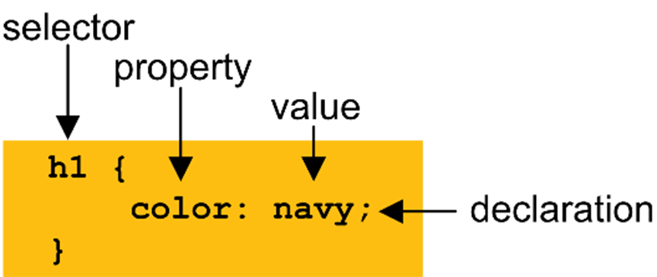
The parts of a CSS style rule

Slide 13
A simple CSS document with comments
/*********************************************************
* Description: Primary style sheet for valleytownhall.com
* Author: Anne Boehm
*********************************************************/
body {
background-color: #FACD8A; /* This is a shade of orange. */
}
h1 {
color: #363636;
}
h2 {
font-style: italic;
border-bottom: 3px solid #EF9C00; /* Add a line below h2s */
}
ul {
list-style-type: square; /* Changes the bullets to squares */
}

Slide 14
Elements that can be selected by type, id, or class
<body>
<h1 class="base_color">Student materials</h1>
<p>Here are the links for the downloads:</p>
<ul id="links">
<li><a href="exercises.html">Exercises</a></li>
<li><a href="solutions.html">Solutions</a></li>
</ul>
<p id="copyright" class="base_color">Copyright 2018</p>
</body>

Slide 15
CSS style rules that select by type, id, and class
Type
body {
font-family: Arial, sans-serif;
font-size: 100%;
width: 300px;
padding: 1em; }
h1 {
font-size: 180%;
}
ID
#copyright {
font-size: 75%;
text-align: right;
}
Class
.base_color {
color: blue;
}

Slide 16
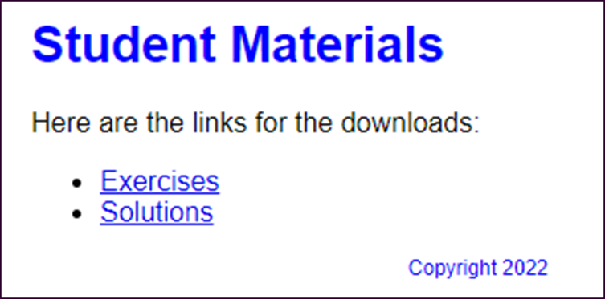
The elements in a browser

Slide 17
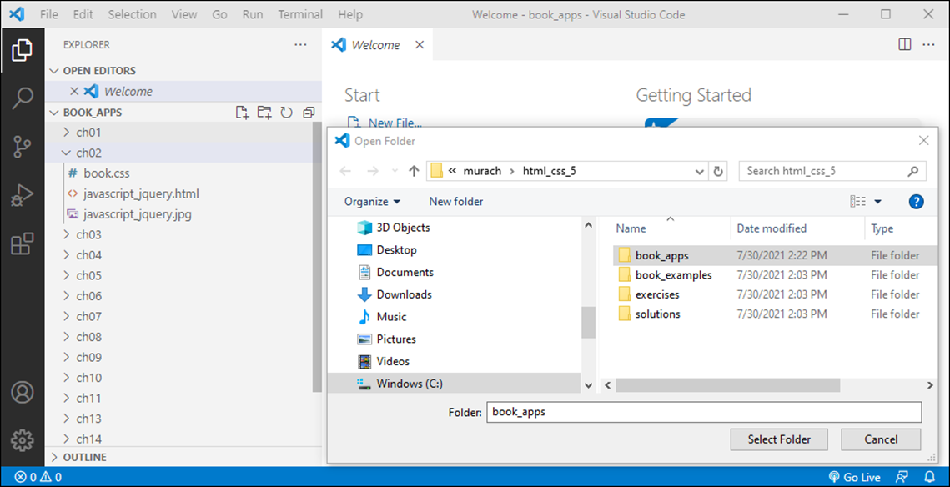
The VS Code dialog box for choosing a folder

Slide 18
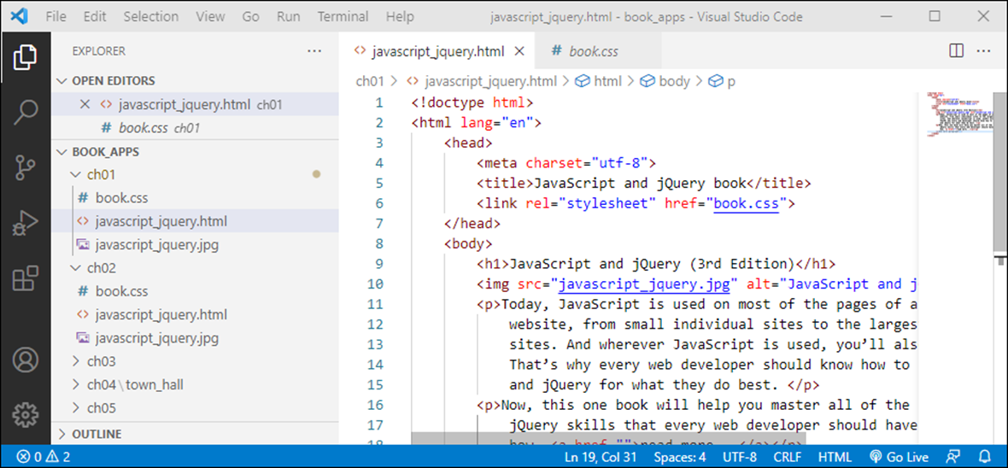
VS Code with files in Standard and Preview mode

Slide 19
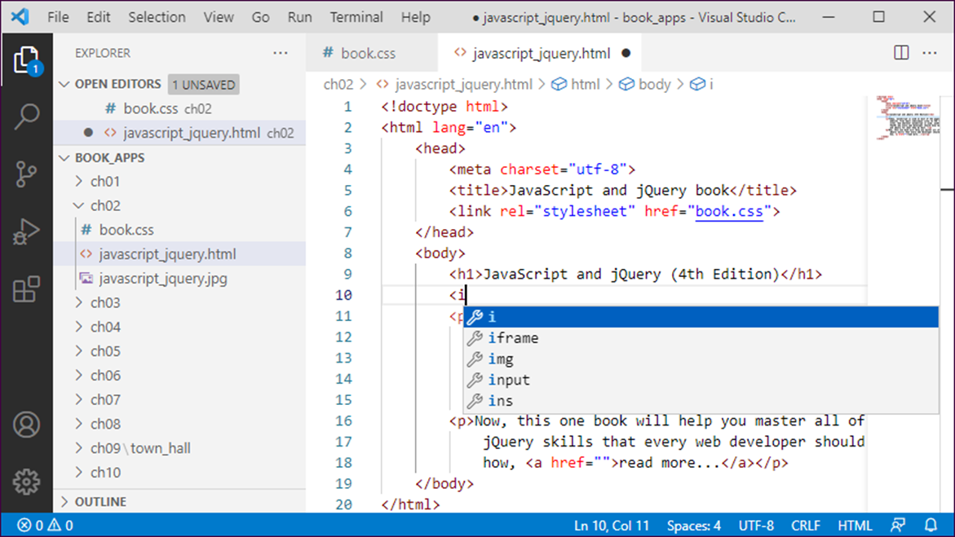
The completion list for selecting an HTML element

Slide 20
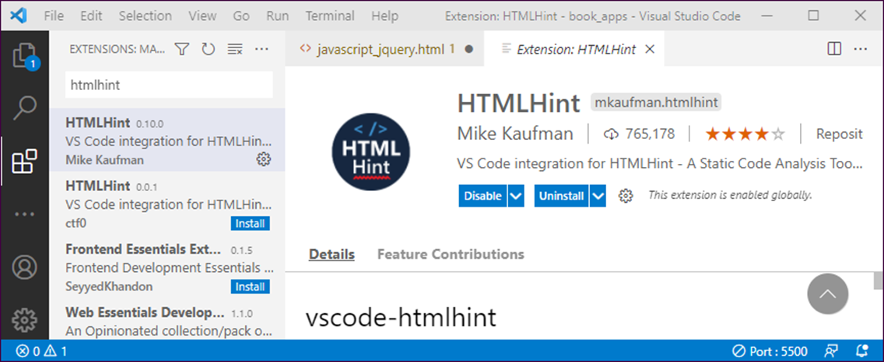
VS Code as the HTMLHint extension is installed

Slide 21
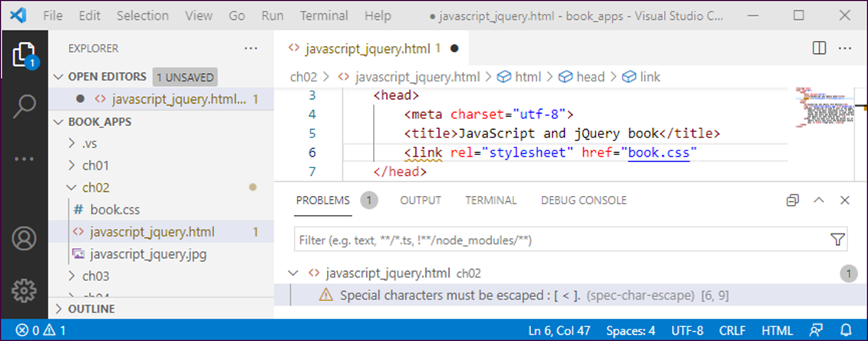
The Problems window with an error displayed

Slide 22
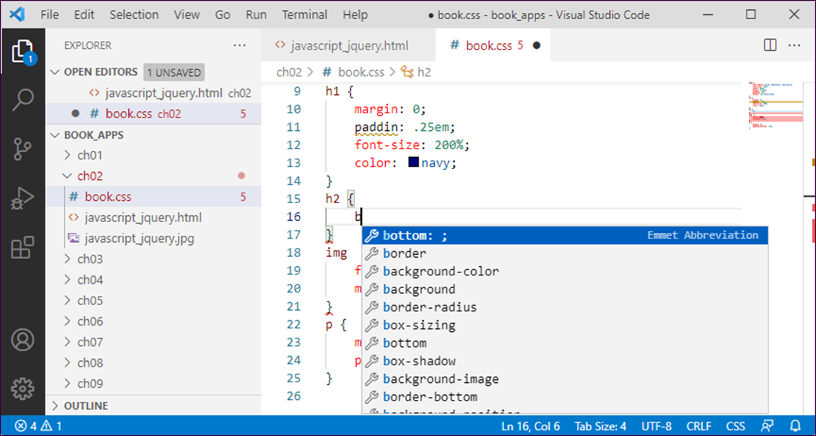
The completion list for selecting a CSS property

Slide 23
Common HTML and CSS errors
Common HTML errors
An opening tag without a closing tag.
Misspelled tag or attribute names.
Quotation marks that aren’t paired.
Incorrect file references in link, img, or <a> elements.
Common CSS errors
Braces that aren’t paired correctly.
Missing semicolons.
Misspelled property names.
Id or class names that don’t match the names used in the HTML.

Slide 24
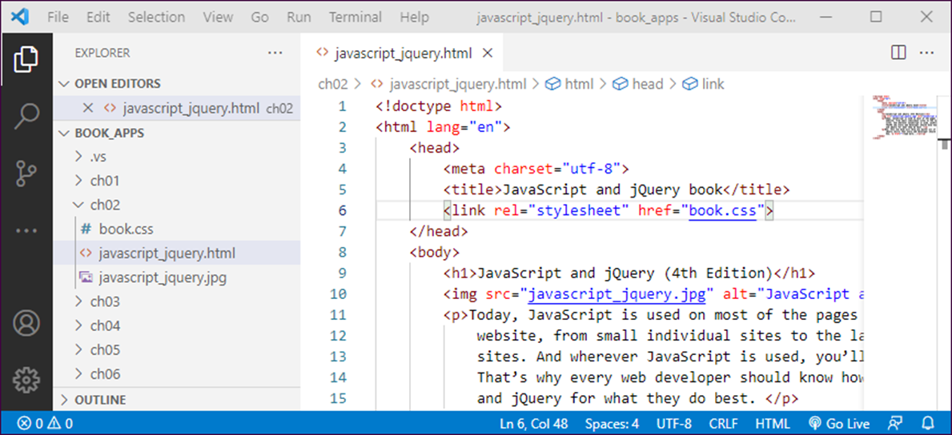
Click the Go Live icon to open an HTML file on a development server

Slide 25
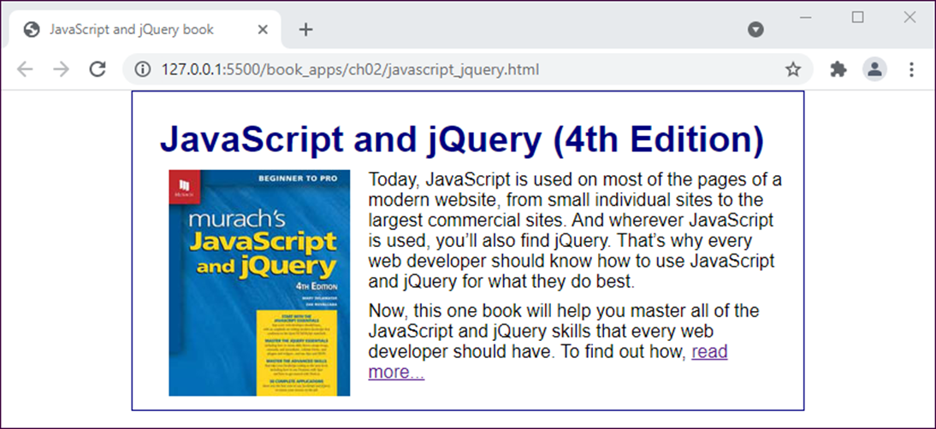
The Chrome browser in Live Server mode

Slide 26
Two ways to run a web page that’s on your computer or a local network
Use the features of your text editor or IDE, like Live Server with VS Code.
Find the file in your file explorer. Then, double-click on it to open it in your default browser. Or, right-click on it and use the Open With command to select the browser.

Slide 27
How to test and debug a web page
How to test a web page
Check the contents and appearance of each page.
Click on all of the links on each page to make sure they work properly.
After you’ve tested your web pages on one browser, test them on the other browsers that your users may be using.
How to debug a web page
To find the causes of your errors, you can use Chrome’s Developer Tools. This tool shows you how the CSS relates to the HTML.
After you find the cause of an error and fix it, you test the page again. To do that, you can switch to the browser from your text editor or IDE and then click the Refresh or Reload icon.

Slide 28
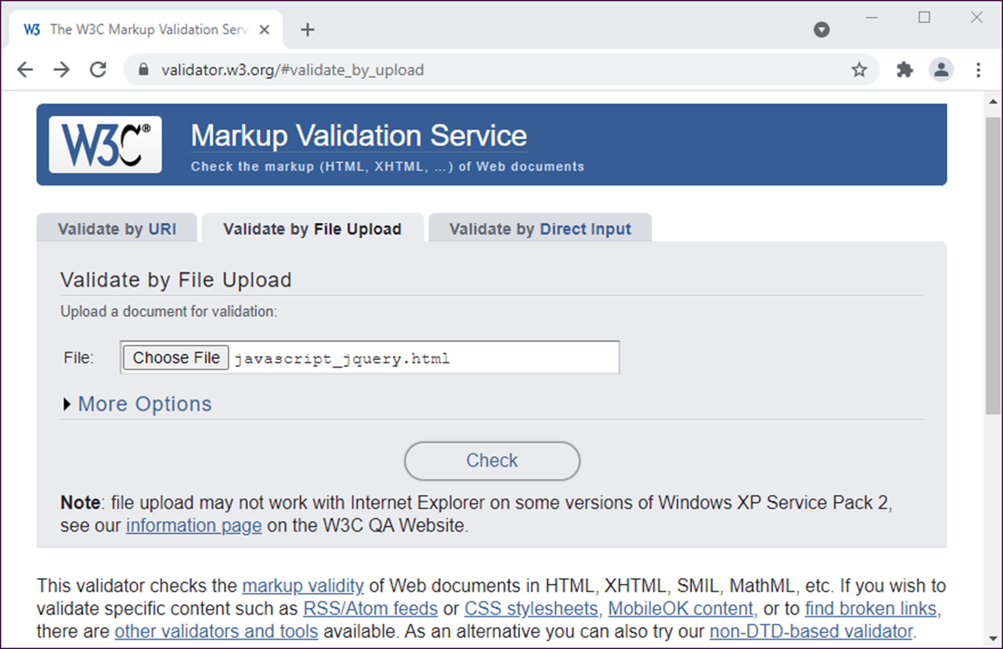
The home page for the W3C Markup validator

Slide 29
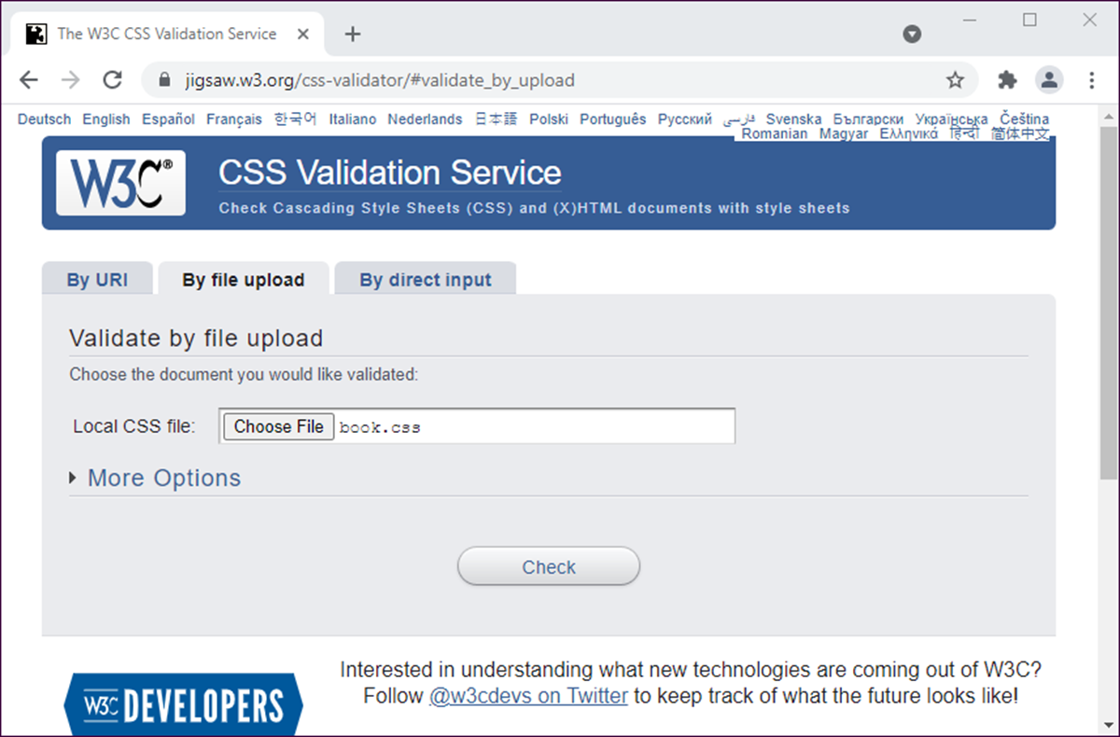
The home page for the W3C CSS validator

